Slide 1

Practical 12
Program to Find Maximum Depth or Height of a Binary Tree

Slide 2

Lesson Plan
Subject/Course | Competitive Coding
Lesson Title | Program to Find Maximum Depth or Height of a Binary Tree
Lesson Objectives
Understand the concept of depth and height in a binary tree.
Learn how to calculate the maximum depth using recursion.
Explore how height relates to levels in a binary tree.
Analyze time and space complexity of the height algorithm.

Slide 3
Problem Statement:
Write a program for implementing a MINSTACK which should support operations like push, pop, overflow, underflow, display.
1. Construct a stack of N-capacity
2. Push elements
3. Pop elements
4. Top element
5. Retrieve the min element from the stack

Slide 4
Concept
What is Depth (Height) of a Tree?
The depth or height of a binary tree is the number of nodes along the longest path from the root node down to the farthest leaf node.
Example:
Depth of a single node tree = 1
Depth of an empty tree = 0
Key Idea (Recursive Definition):
maxDepth(node) = 1 + max(maxDepth(left subtree), maxDepth(right subtree))

Slide 5
Algorithm/Logic
1. If root is null → return 0.
2. Recursively find height of left subtree.
3. Recursively find height of right subtree.
4. Return 1 + maximum of left and right heights.
5. Base condition handles empty trees automatically.

Slide 6
Algorithm/Logic
Example Steps:
1. Move recursively to leftmost and rightmost nodes.
2. Compute heights bottom-up.
3. Add 1 for each parent level on return.
4. Final result gives total height of the tree.

Slide 7
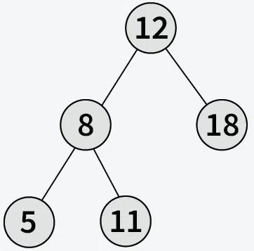
Visualization
Example Tree:
Depth Calculation:
Depth(5) = 1
Depth(11) = 1
Depth(8) = 1 + max(1, 1) = 2
Depth(12) = 1 + max(1, 2) = 3

Slide 8
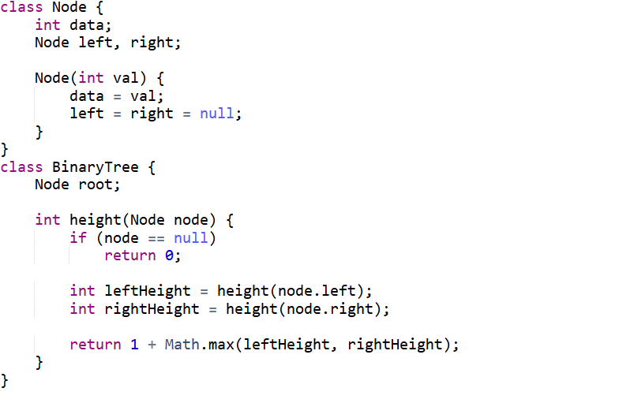
Code Implementation

Slide 9
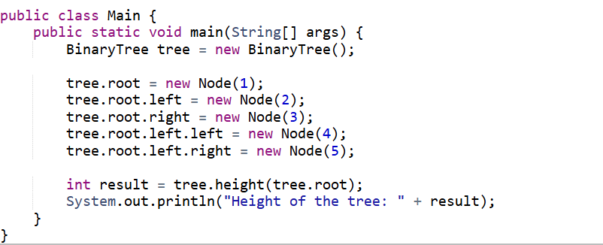

Slide 10

Output

Slide 11
Time & Space Complexity
Time Complexity:
O(n) – each node is visited once.
Space Complexity:
O(h) – due to recursion stack (h = height of tree).

Slide 12
Summary
1. Height is the longest path from root to leaf.
2. Recursive approach computes height efficiently.
3. Time Complexity: O(n), Space: O(h).
4. Used in balance checking, diameter, and level-order traversal.

Slide 13
Practice Questions:
1. Maximum Depth of Binary Tree — LeetCode #104
🔗https://leetcode.com/problems/maximum-depth-of-binary-tree/
Concept: Find height using recursive traversal.
Why Practice: Core concept for many tree problems.

Slide 14
Practice Questions:
2. Minimum Depth of Binary Tree — LeetCode #111
🔗 https://leetcode.com/problems/minimum-depth-of-binary-tree/
Concept: Find shortest path from root to a leaf.
Why Practice: Complements maximum depth understanding.

Slide 15
Practice Questions:
3. Diameter of Binary Tree — LeetCode #543
🔗https://leetcode.com/problems/diameter-of-binary-tree/
Concept: Compute the longest path between any two nodes in the tree using depth logic.
Why Practice: Extends the max depth concept — shows how tree depth contributes to diameter calculation.

Slide 16
Thanks

